Slide 1
Rotating online behavior change interventions increases effectiveness but also increases attrition
Geza Kovacs
Zhengxuan Wu
Michael Bernstein
Stanford HCI Group
Notes:
II

Slide 2
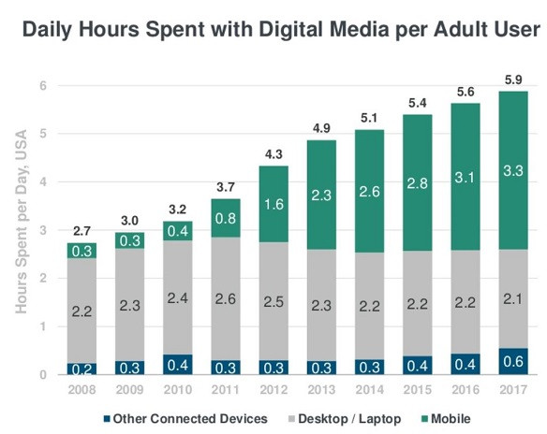
People spend increasing amounts of time online
Average adult spends 5.9 hours per day with digital media

Slide 3

People struggle to reduce their time online
Kim, Young-Ho, et al. "TimeAware: Leveraging framing effects to enhance personal productivity." Proceedings of the 2016 CHI Conference on Human Factors in Computing Systems. ACM, 2016.
Andreassen, Cecilie Schou, et al. "Development of a Facebook addiction scale." Psychological reports 110.2 (2012): 501-517.

Slide 4

Behavior change interventions suffer from declined engagement over time
Paul Krebs, James O Prochaska, and Joseph S Rossi. 2010. A meta-analysis of computer-tailored interventions for health behavior change. Preventive medicine 51, 3-4 (2010), 214–221

Slide 5

Novelty effects can provide temporary boosts in engagement
Reza Kormi nouri, Lars Goran Nilson, and Nobuo Ohta. [n. d.]. The novelty effect: Support for the Novelty Encoding Hypothesis. Scandinavian Journal of Psychology

Slide 6


Existing behavior change systems tend to use static interventions

Slide 7

[RQ] Can a strategy of rotating interventions improve effectiveness?

Slide 8

[H1] Static interventions suffer from decreased effectiveness over time

Slide 9

[H2] Rotation will increase intervention effectiveness

Slide 10
Why study novelty effects in online behavior change?
Can measure effectiveness (time spent per visit)
Many interventions possible (can modify sites)
Can frequently alter interventions (can change intervention every visit)

Slide 11
Motivation
The Habitlab Chrome Extension
Study 1
Study 2
Qualitative feedback
Study 3

Slide 12
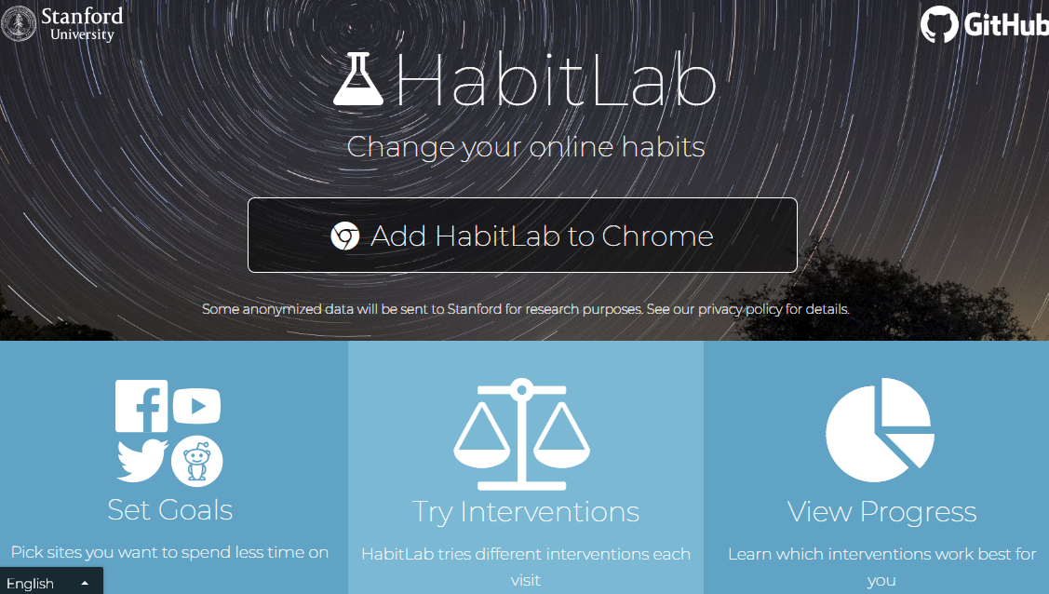
HabitLab
Our browser behavior change platform
8000+ in-the-wild active users

Slide 13
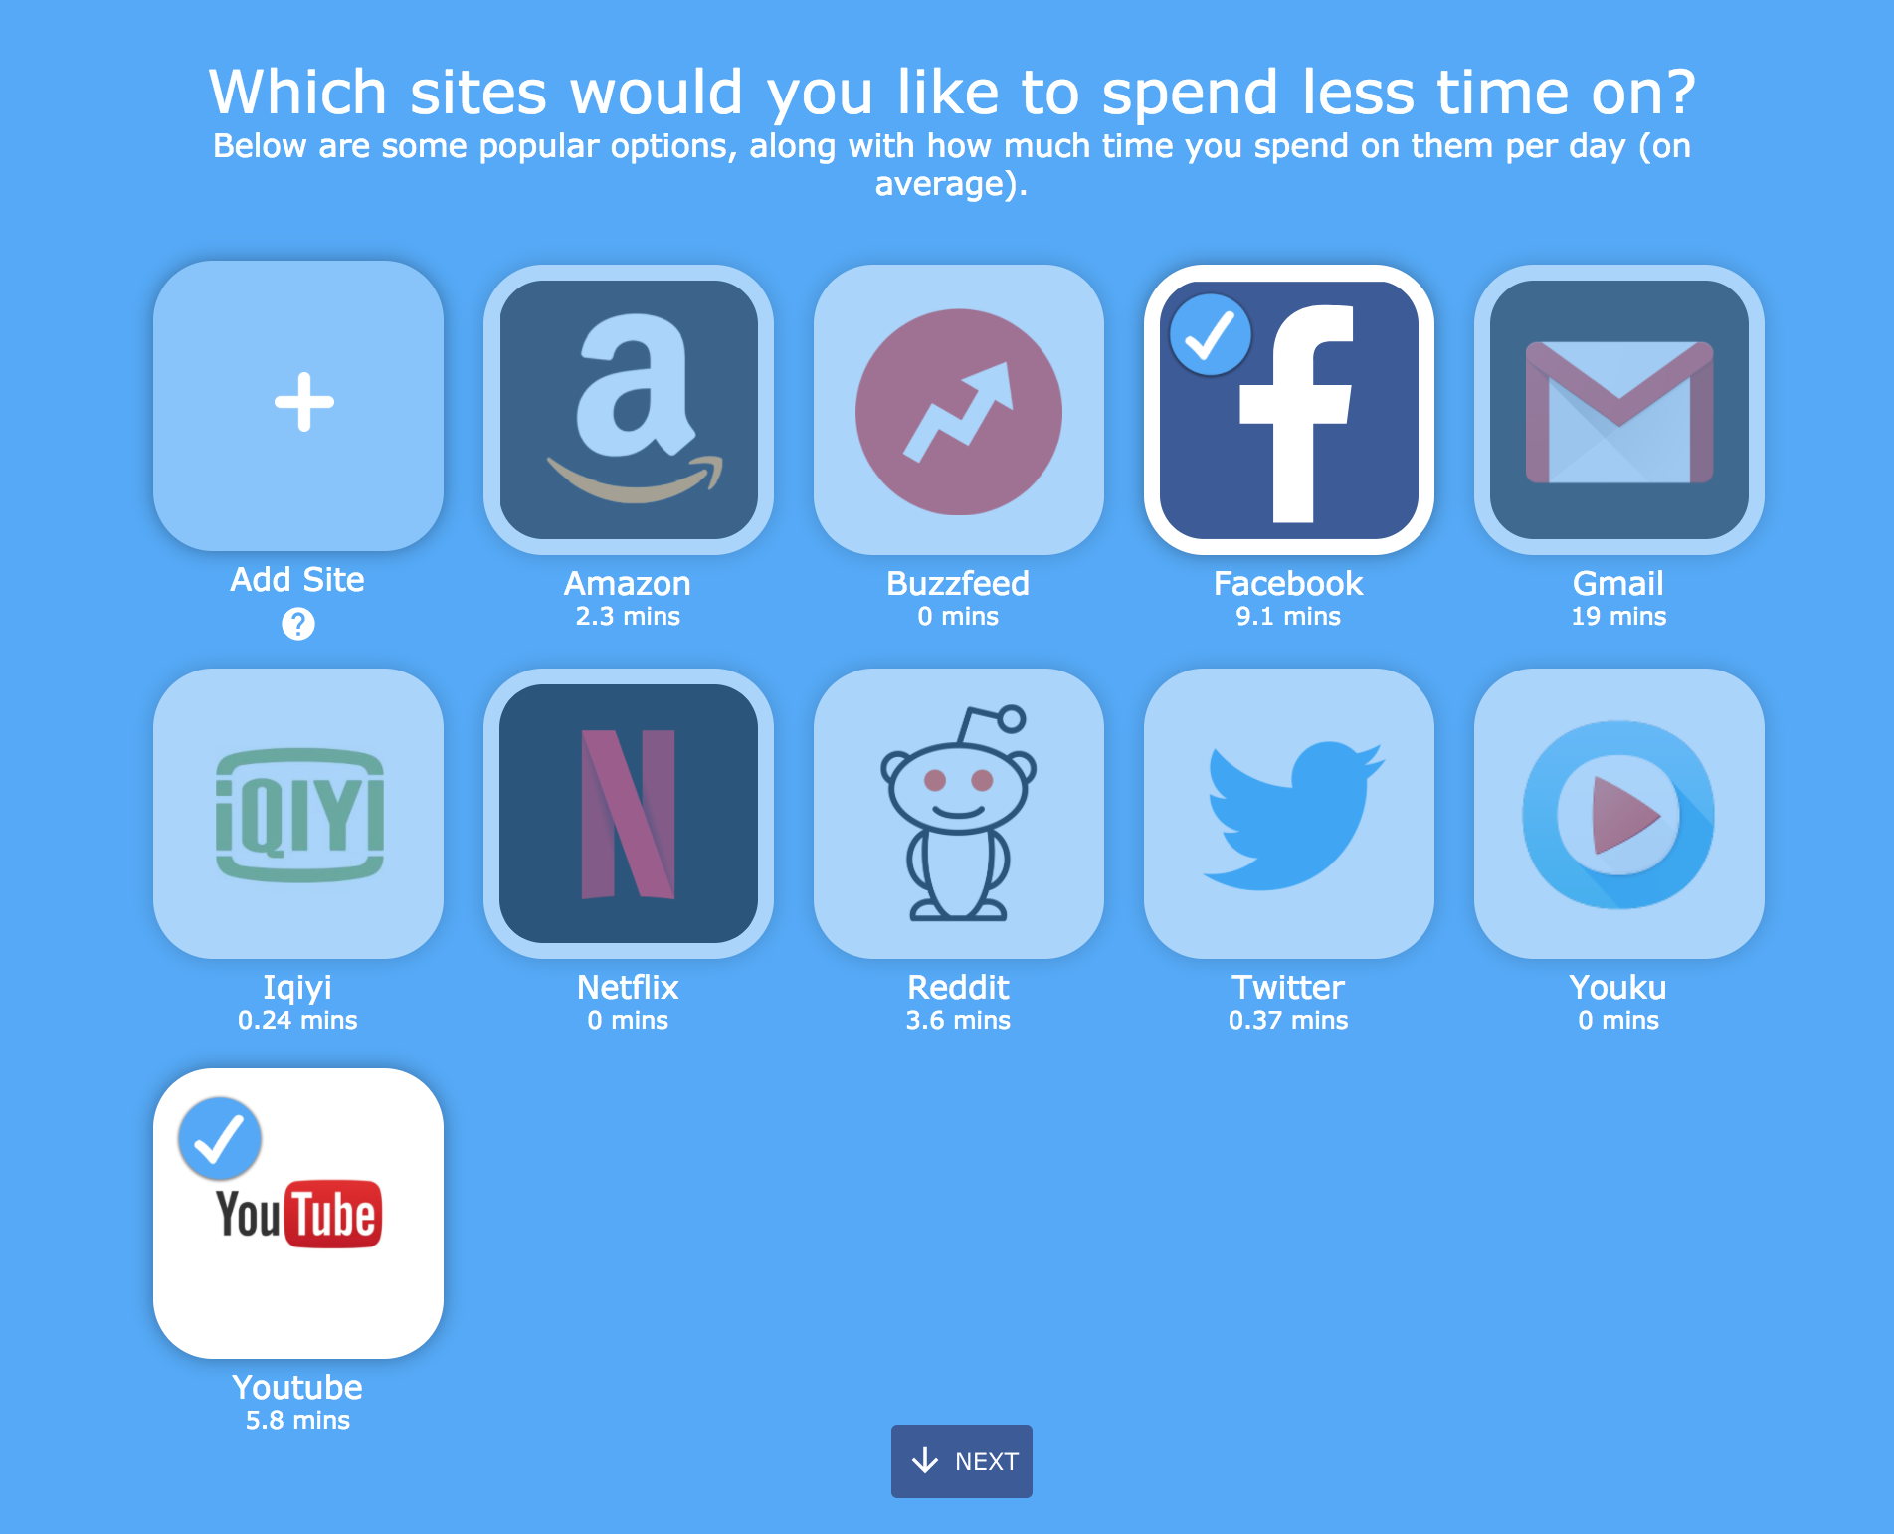
Users select sites to reduce time on (goals)

Slide 14
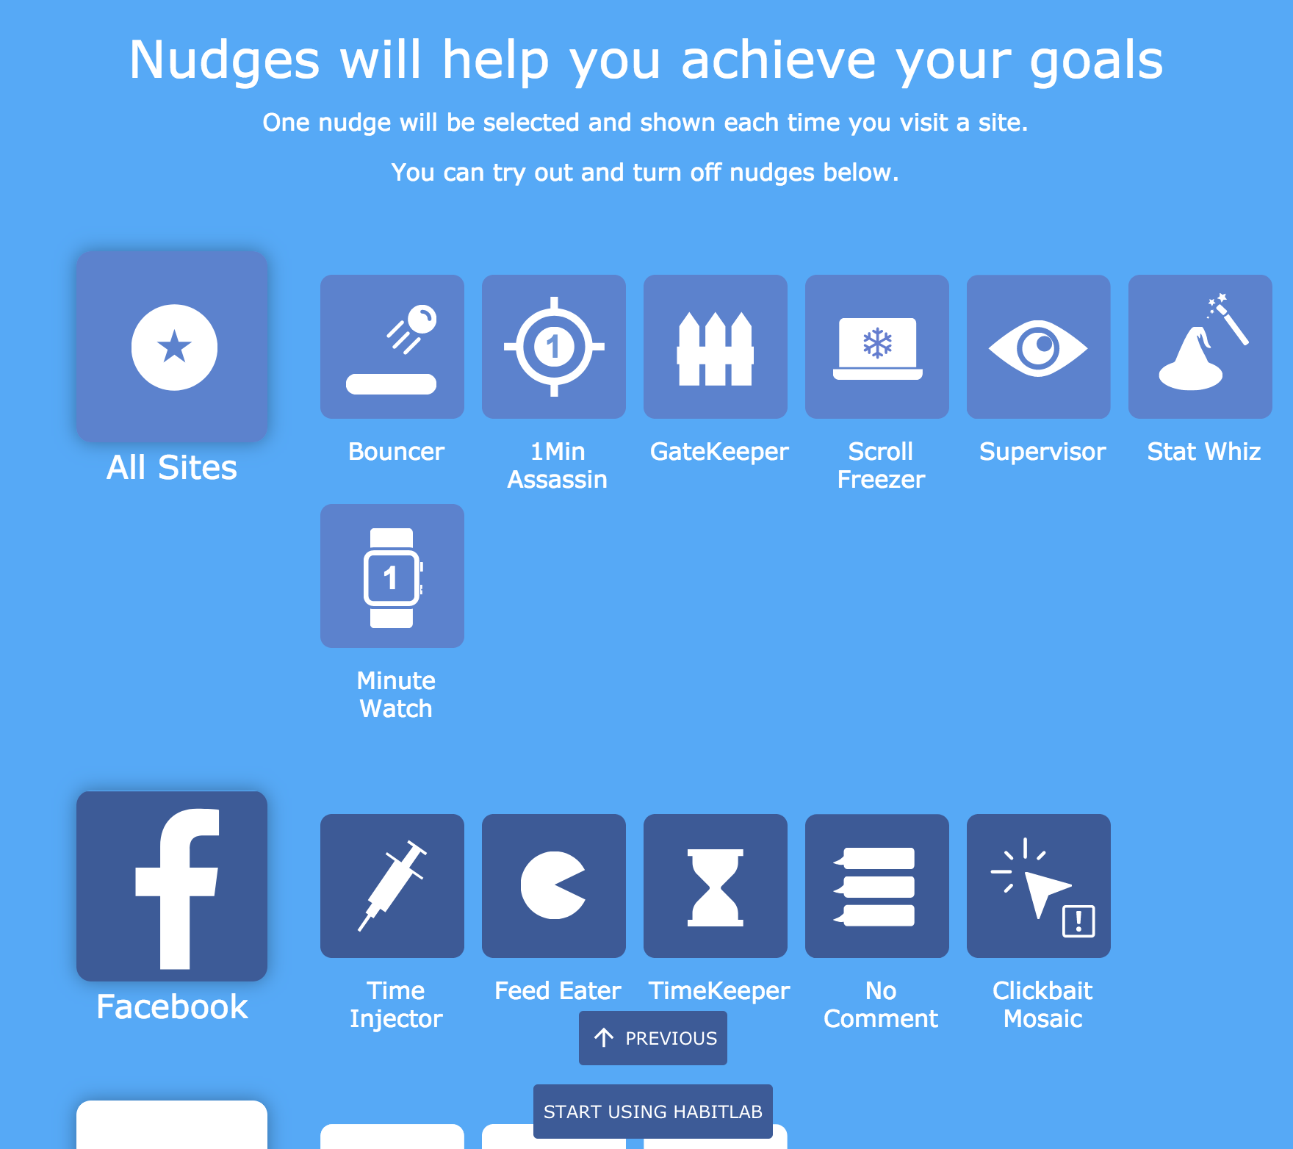
Interventions help reduce time on sites

Slide 15
Design process for interventions
Existing interventions on the Chrome Store
Ideas proposed by experts and users
Adaptations of techniques from the literature

Slide 16
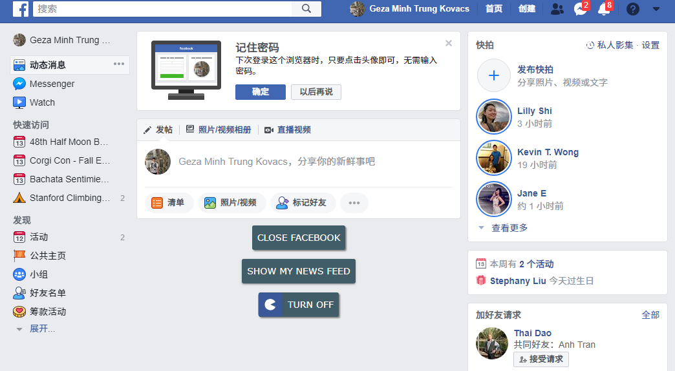

Slide 17
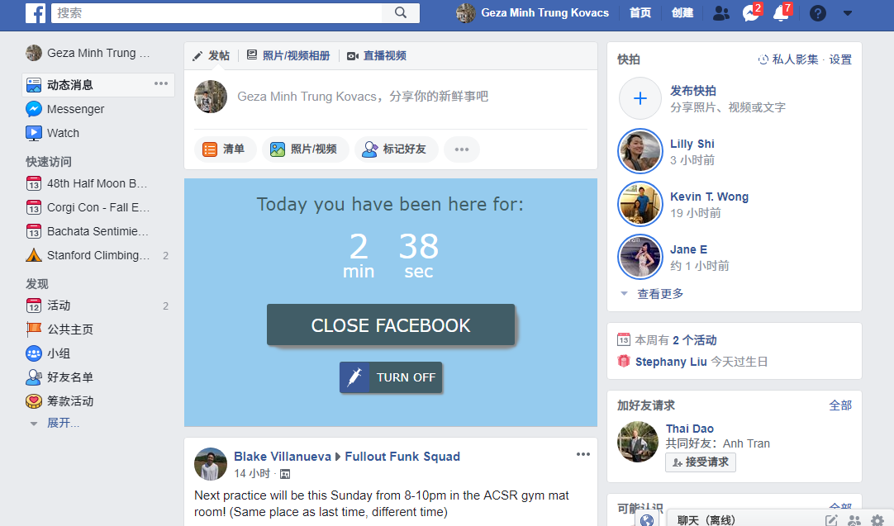


Slide 18
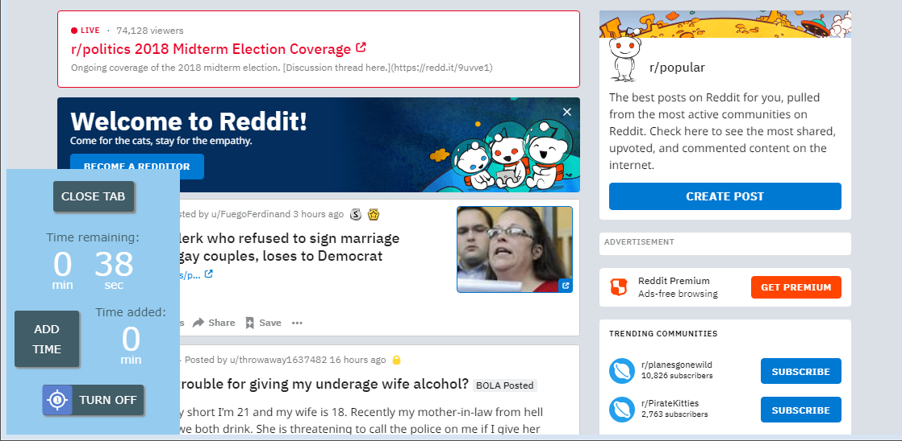

Slide 19
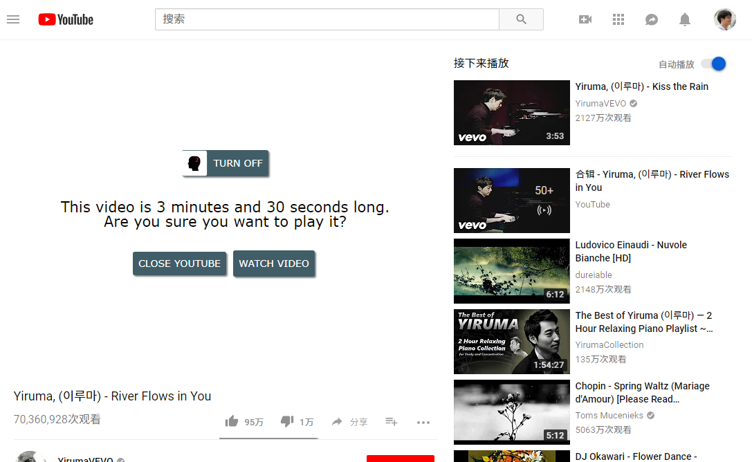

Slide 20
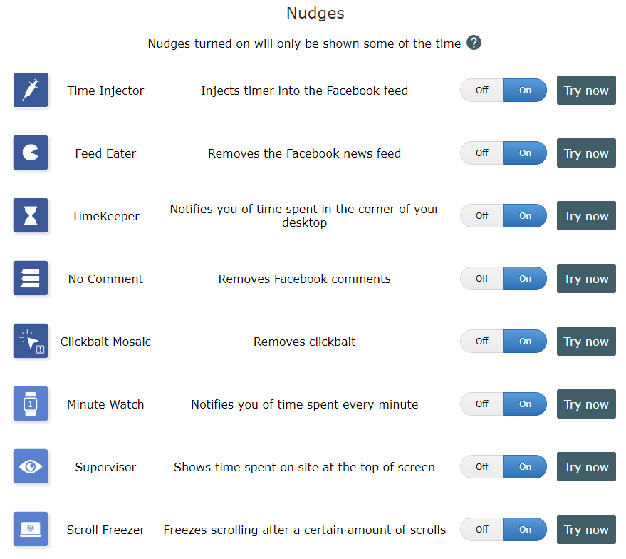
30+ interventions available

Slide 21
Motivation
The Habitlab Chrome Extension
Study 1
Study 2
Qualitative feedback
Study 3

Slide 22
Compare rotating and static intervention strategies, in terms of:
Effectiveness of interventions over time (daily time on sites)
Attrition rates (time until uninstall)

Slide 23
Within-subjects design, 217 participants

Slide 24
Within-subjects design, 217 participants
Conditions: on some days, users saw the same intervention (static), on others, interventions changed each visit (rotation)

Slide 25
Within-subjects design, 217 participants
Conditions: on some days, users saw the same intervention (static), on others, interventions changed each visit (rotation)
Conditions were organized into blocks of 1, 3, 5, 7 days
A block of 1 day static followed by 1 day rotation
S
R
Day 1 2

Slide 26
Within-subjects design, 217 participants
Conditions: on some days, users saw the same intervention (static), on others, interventions changed each visit (rotation)
Conditions were organized into blocks of 1, 3, 5, 7 days
A block of 3 days rotation followed by 3 days static
S
R
R
R
R
S
S
S
Day 1 2 3 4 5 6 7 8

Slide 27
Within-subjects design, 217 participants
Conditions: on some days, users saw the same intervention (static), on others, interventions changed each visit (rotation)
Conditions were organized into blocks of 1, 3, 5, 7 days
A block of 5 days rotation followed by 5 days static
S
R
R
R
R
S
S
S
R
R
R
R
R
S
S
S
S
S
Day 1 2 3 4 5 6 7 8 9 10 11 12 13 14 15 16 17 18

Slide 28
Do static interventions decline in effectiveness over time?
Linear Mixed Model
Fixed effects:
#days intervention seen
Random effects:
User ID, Domain
Dependent variable:
Time spent on domain that day (log)

Slide 29
Time spent on sites increases over time with static interventions (decline in effectiveness)
 | Log time spent per day (dependent variable)
# days static intervention seen | 0.225 (p < 0.05)
Intercept | 4.759
Observations | 124
Interpretation (via exponentiation):
Day 1: 116 seconds per site
Day 2: 146 seconds per site
Day 3: 183 seconds per site

Slide 30
Does rotation reduce time spent?
Linear Mixed Model
Fixed effects:
Condition (static or rotation), Block length
Random effects:
User ID, Domain
Dependent variable:
Time spent on domain that day (log)

Slide 31
 | Log time spent per day (Dependent variable)
Rotation (baseline: static) | -0.417 (p < 0.05)
Intercept | 4.981
Observations | 370
Daily time on sites reduced in the rotation condition
Interpretation (via exponentiation):
Static: 146 seconds per site daily
Rotation: 96 seconds per site daily

Slide 32
Does rotation increase attrition?
Cox hazard regression
Predicting survival probability as a function of condition (static or rotation), within the first block

Slide 33
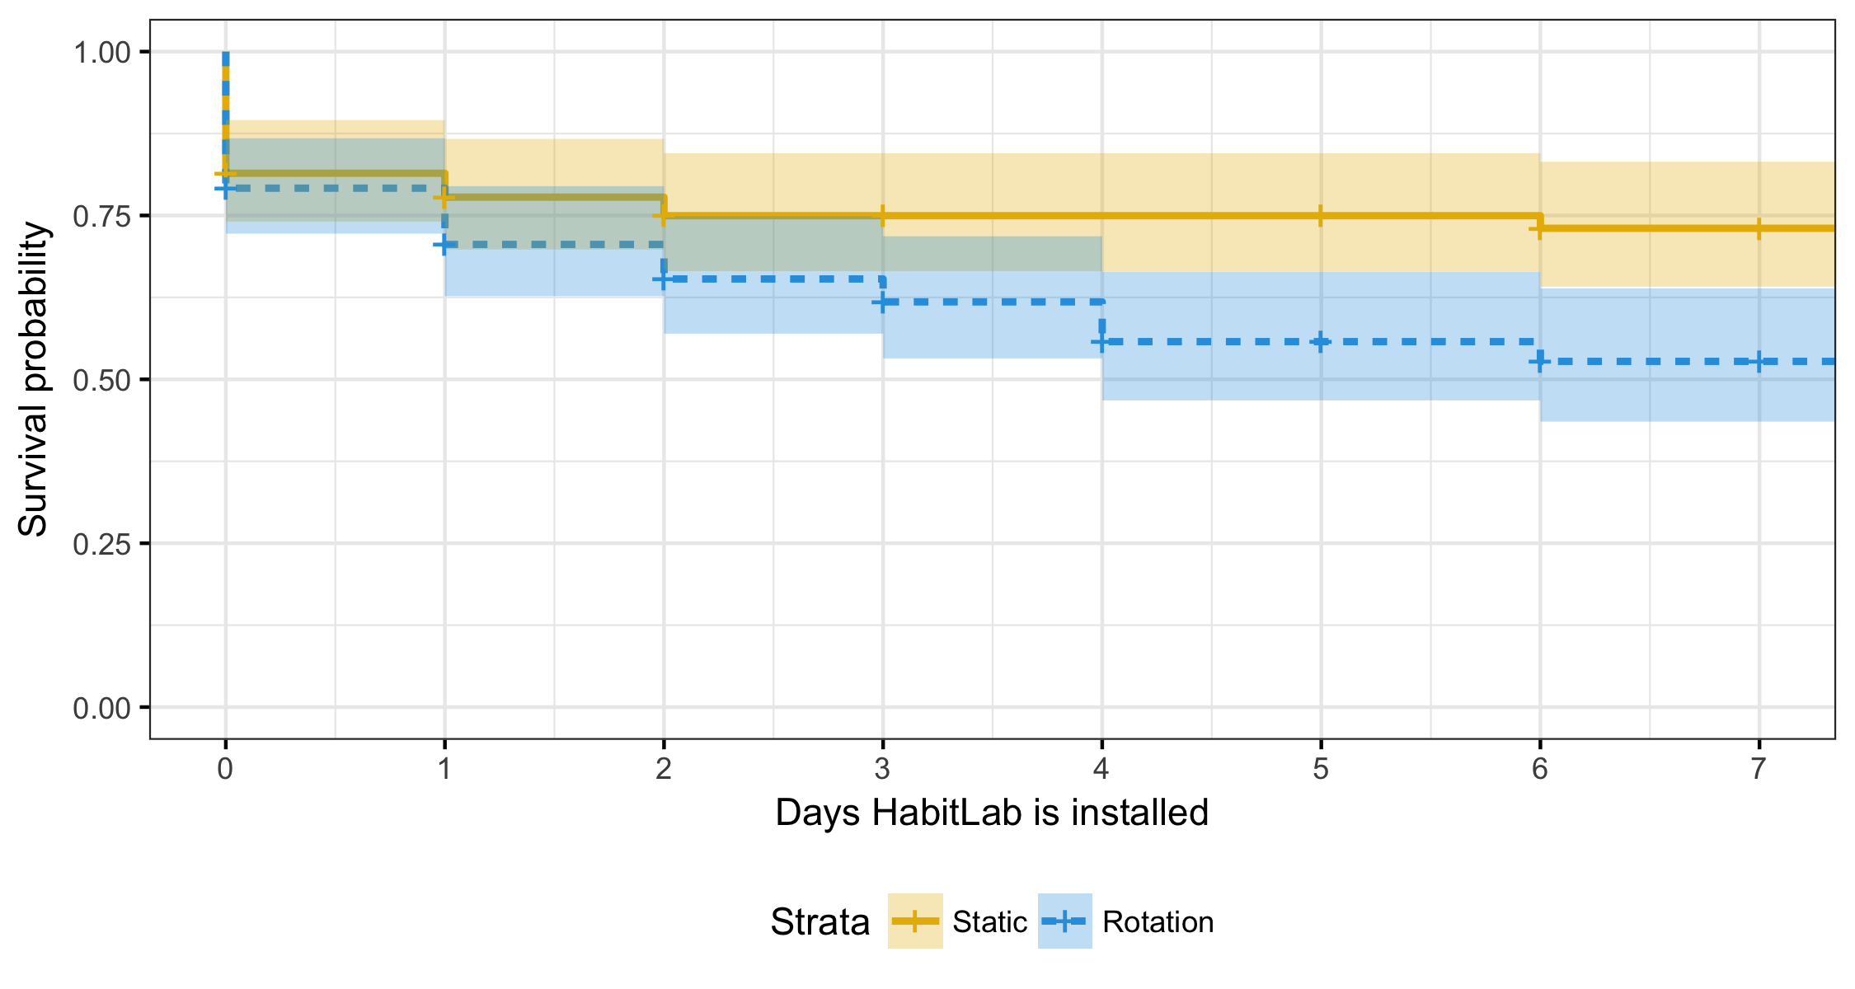
Rotating interventions increases attrition
Survival Probability
Days HabitLab remains installed
Static interventions
Rotating interventions
Log hazard ratio for rotation condition: 0.544 (p < 0.05)

Slide 34
Rotating interventions increases attrition
Static: 74% after a week
Survival Probability
Days HabitLab remains installed
Static interventions
Rotating interventions
Log hazard ratio for rotation condition: 0.544 (p < 0.05)

Slide 35
Rotating interventions increases attrition
Static: 74% after a week
Rotation: 52% after a week
Survival Probability
Days HabitLab remains installed
Static interventions
Rotating interventions
Log hazard ratio for rotation condition: 0.544 (p < 0.05)

Slide 36
Rotating interventions improves effectiveness but increases attrition
Motivation
The Habitlab Chrome Extension
Study 1
Study 2
Qualitative feedback
Study 3

Slide 37
Does rotating between more interventions increase attrition?

Slide 38
Does rotating between more interventions increase attrition?
Between-subjects design, 409 participants, 5 weeks

Slide 39
Does rotating between more interventions increase attrition?
Between-subjects design, 409 participants, 5 weeks
Conditions differ in number of interventions being rotated:
One intervention per site
Half of all available interventions per site (ie, 4 on Facebook)
All available interventions per site (ie, 8 on Facebook)

Slide 40
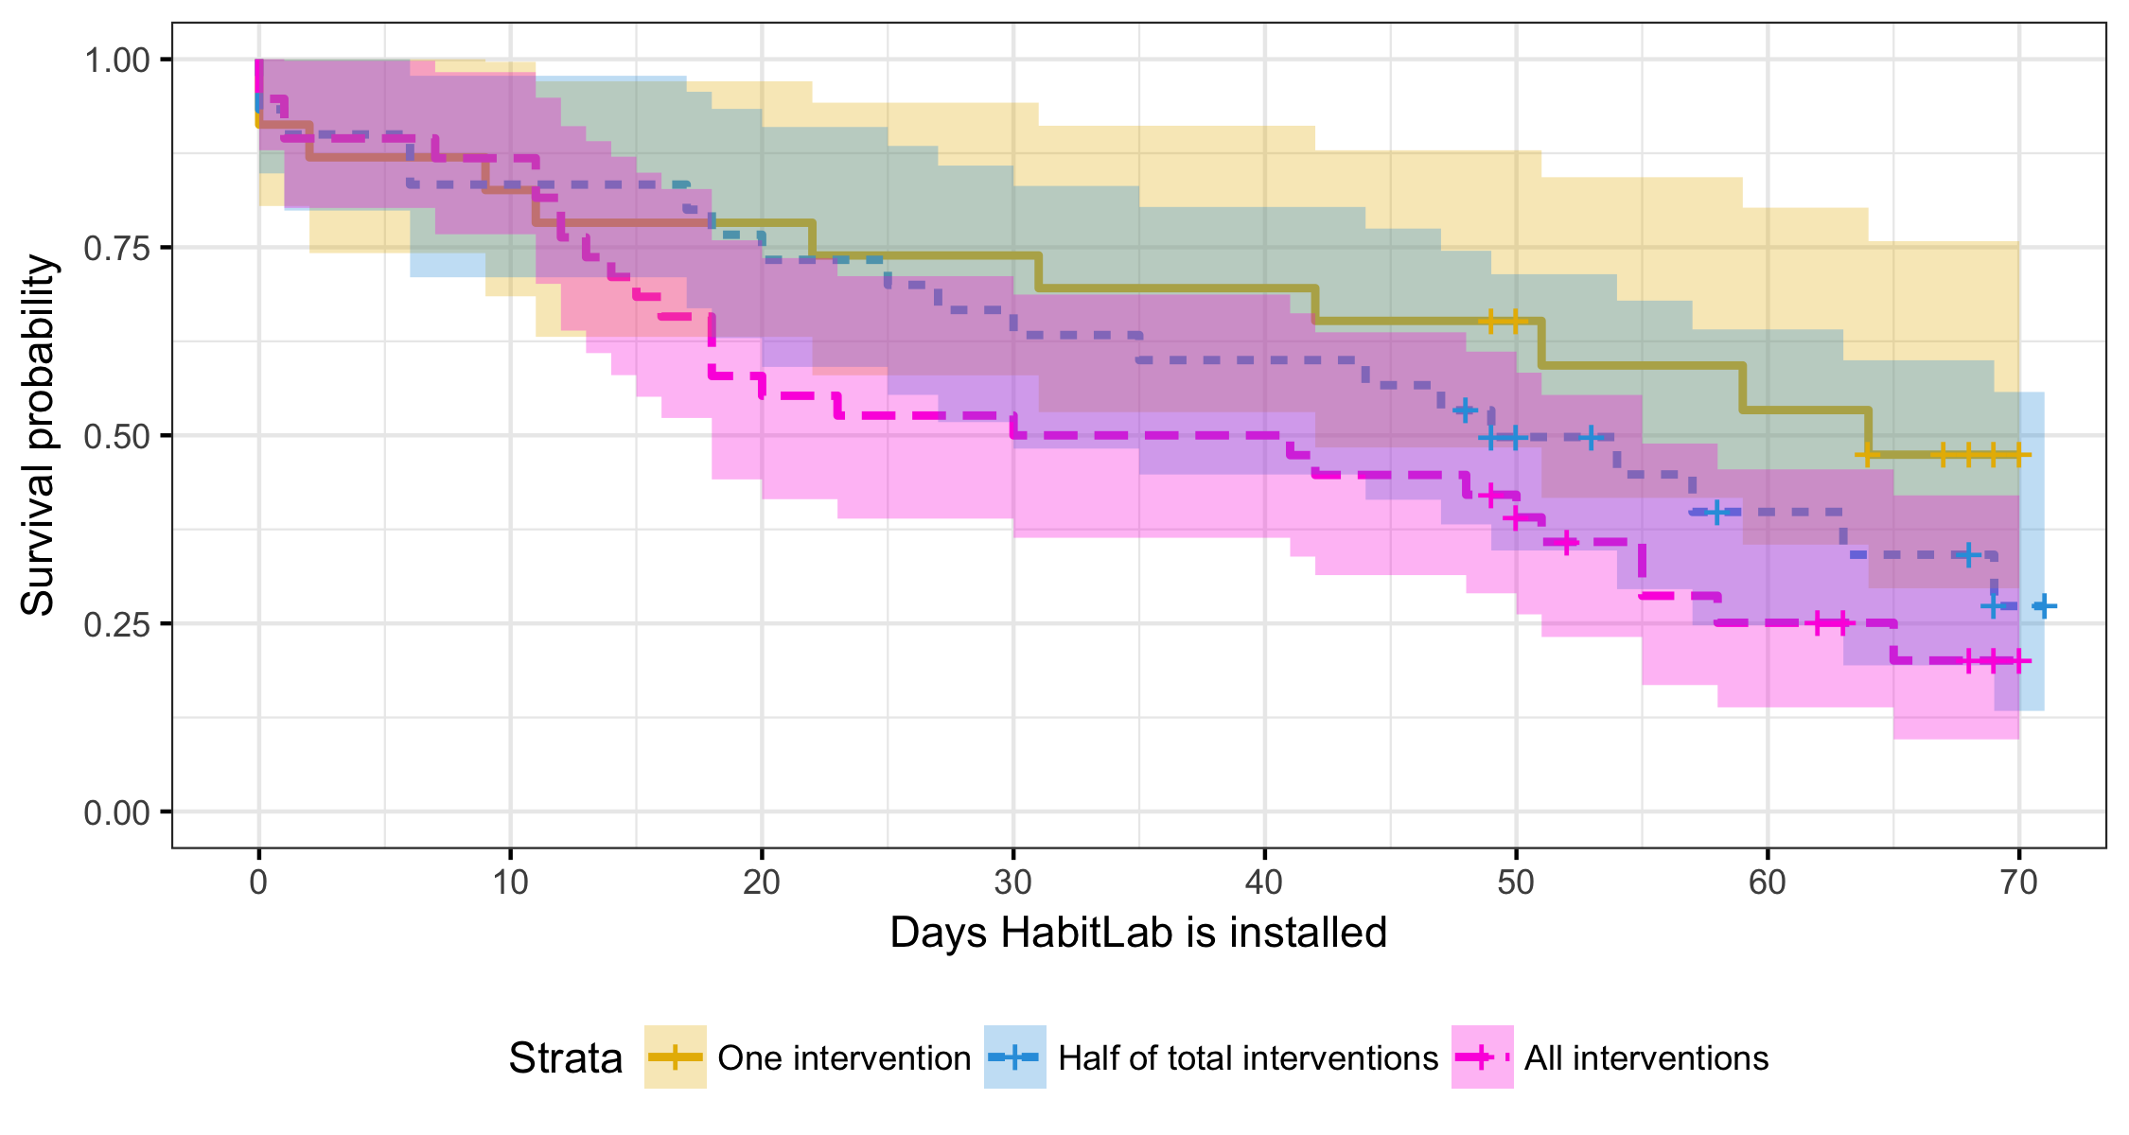
Rotating between interventions increases attrition
Survival Probability
Days HabitLab remains installed
One intervention
Half of total interventions
All interventions

Slide 41
Rotating between interventions increases attrition
Survival Probability
One: 47% after 70 days
Days HabitLab remains installed
One intervention
Half of total interventions
All interventions

Slide 42
Rotating between interventions increases attrition
Survival Probability
One: 47% after 70 days
Half: 27% after 70 days
Days HabitLab remains installed
One intervention
Half of total interventions
All interventions

Slide 43
Rotating between interventions increases attrition
Survival Probability
One: 47% after 70 days
Half: 27% after 70 days
All: 20% after 70 days
Days HabitLab remains installed
One intervention
Half of total interventions
All interventions

Slide 44
Rotating between interventions increases attrition
Survival Probability
One: 47% after 70 days
P < 0.05
Significant
Half: 27% after 70 days
All: 20% after 70 days
Days HabitLab remains installed
One intervention
Half of total interventions
All interventions

Slide 45
Rotating interventions itself causes attrition
Motivation
The Habitlab Chrome Extension
Study 1
Study 2
Qualitative feedback
Study 3

Slide 46
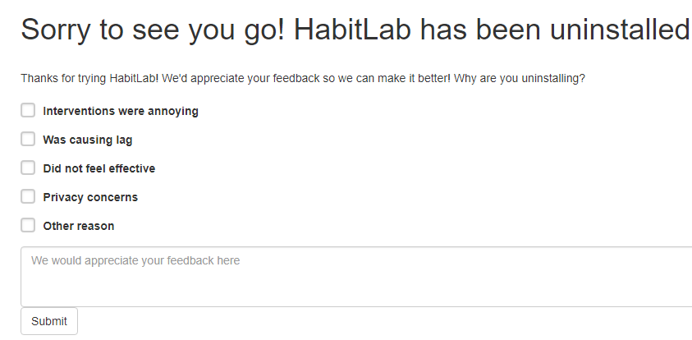
Collected uninstall feedback to understand reasons for attrition

Slide 47
Collected uninstall feedback to understand reasons for attrition
Incorrect mental models
Didn’t seem what I was expected. Installed two minutes ago and removed it
Dissatisfaction with particular interventions
Mostly it was the bar covering up facebook message indicators

Slide 48
Why did rotating interventions increase attrition?
Violation of mental models
Users lack sense of control

Slide 49
Rotating interventions improves effectiveness but increases attrition
Motivation
The Habitlab Chrome Extension
Study 1
Study 2
Qualitative feedback
Study 3

Slide 50
Can we reduce attrition when intervention rotation happens?
Developed 2 dialogs shown when an intervention is first seen
Mental model design
User control design

Slide 51
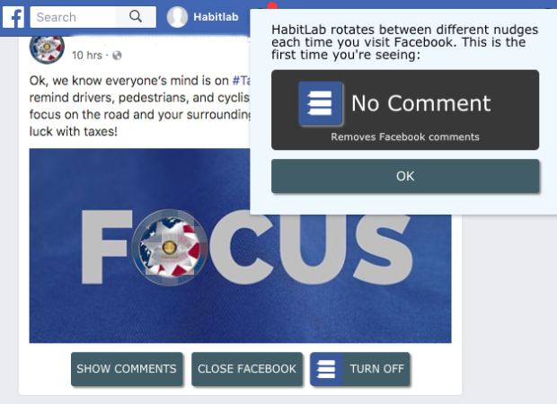
Mental model design

Slide 52
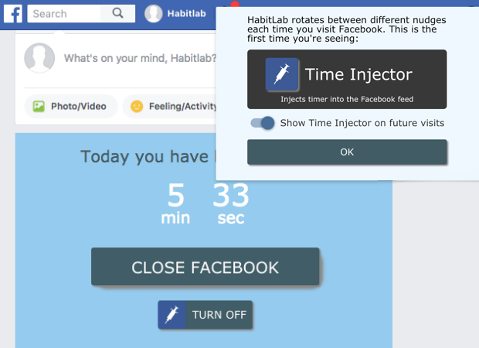
User control design

Slide 53
Between subjects design, 282 participants, 10 days
Conditions differ according to which design is shown when an intervention is seen for the first time:
None: No design shown
Mental model design
User control design

Slide 54
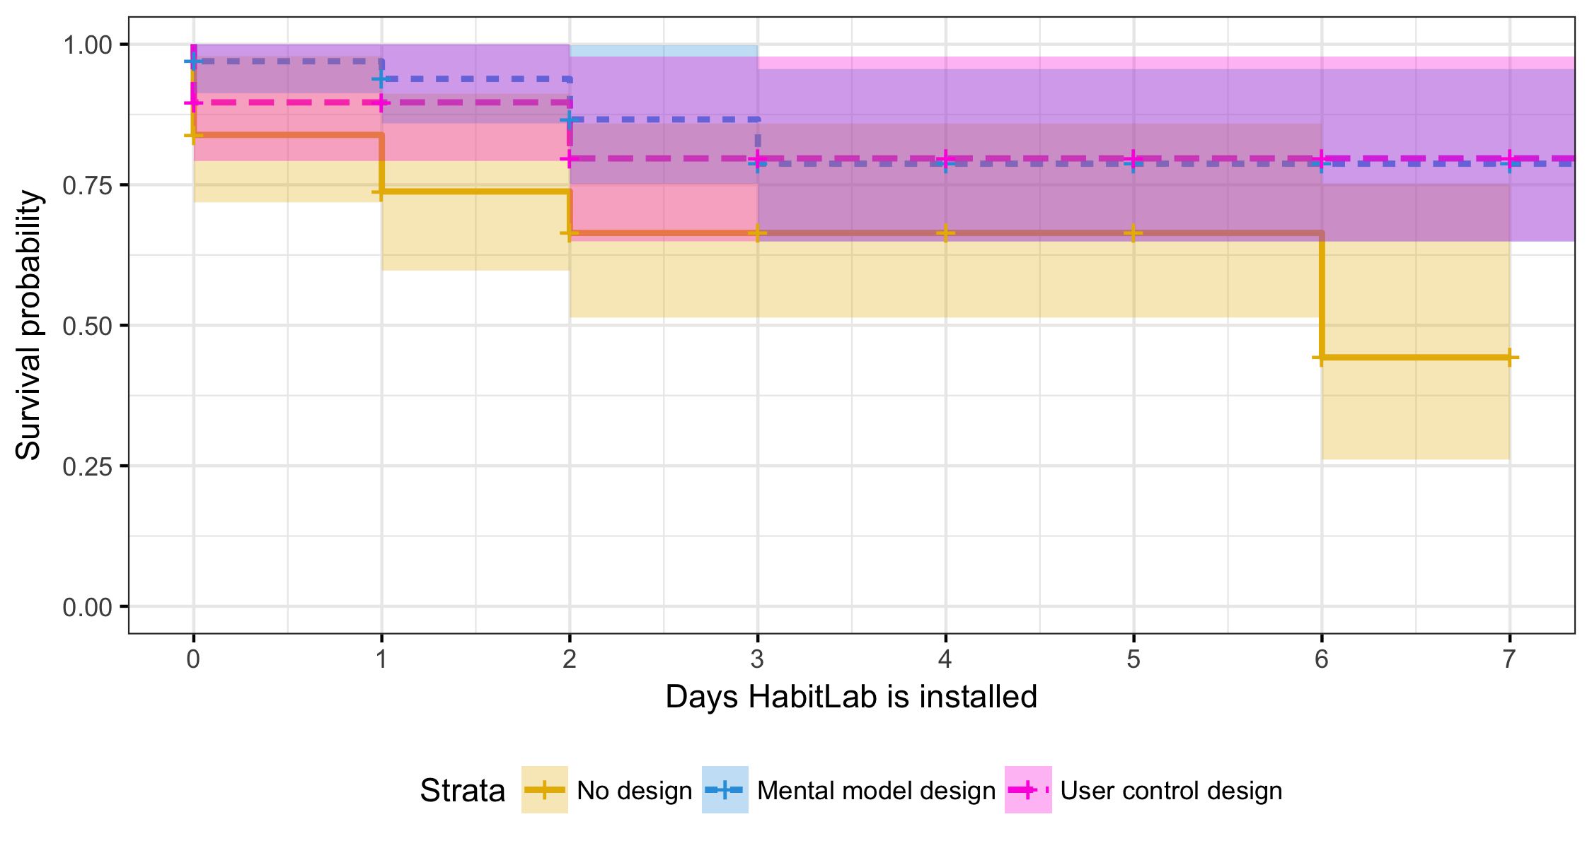
Mental model design reduces attrition by half
Survival probability
Days HabitLab remains installed
No design
Mental model design
User control design
Design | Log hazard ratio
Mental model | -1.015 (p < 0.05)
User control | -0.869
Notes:
Missing y axis label. Specify that when measuring attrition we are all using new users
Literature on just on time interventions. Klanska schuller

Slide 55
Mental model design reduces attrition by half
Survival probability
None: 43% after 7 days
Days HabitLab remains installed
No design
Mental model design
User control design
Design | Log hazard ratio
Mental model | -1.015 (p < 0.05)
User control | -0.869
Notes:
Missing y axis label. Specify that when measuring attrition we are all using new users
Literature on just on time interventions. Klanska schuller

Slide 56
Mental model design reduces attrition by half
Mental model: 78% after 7 days
Survival probability
None: 43% after 7 days
Days HabitLab remains installed
No design
Mental model design
User control design
Design | Log hazard ratio
Mental model | -1.015 (p < 0.05)
User control | -0.869
Notes:
Missing y axis label. Specify that when measuring attrition we are all using new users
Literature on just on time interventions. Klanska schuller

Slide 57
Mental model design reduces attrition by half
User control: 78% after 7 days
Mental model: 78% after 7 days
Survival probability
None: 43% after 7 days
Days HabitLab remains installed
No design
Mental model design
User control design
Design | Log hazard ratio
Mental model | -1.015 (p < 0.05)
User control | -0.869
Notes:
Missing y axis label. Specify that when measuring attrition we are all using new users
Literature on just on time interventions. Klanska schuller

Slide 58
Mental model design reduces attrition by half
User control: 78% after 7 days
Mental model: 78% after 7 days
Survival probability
Significant
Significant
None: 43% after 7 days
Days HabitLab remains installed
No design
Mental model design
User control design
Design | Log hazard ratio
Mental model | -1.015 (p < 0.05)
User control | -0.869
Notes:
Missing y axis label. Specify that when measuring attrition we are all using new users
Literature on just on time interventions. Klanska schuller

Slide 59
Conclusions
Static interventions decline in effectiveness over time
Rotating interventions improves effectiveness but increases attrition
Attrition may be due to incorrect mental models and lack of control
We can reduce attrition with a simple design that improves users’ mental models
Rotating online behavior change interventions increases effectiveness but also increases attrition
Geza Kovacs geza@cs.stanford.edu

